Slide 1

The NHL Playoff Picture
Zach Shearin
Rensselaer Polytechnic Institute Industrial and Management Engineering Undergraduate

Slide 2

Agenda
Background
Objective/Motivation
NHL Point Systems
Optimization Model
Data Collection
Statistical Analysis
Suggestions for Change

Slide 3
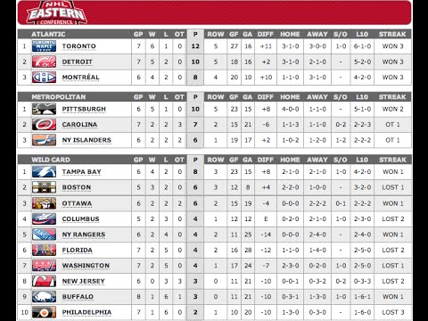
NHL Current Point System
 | Regular Time | Overtime
Points for Win | 2 | 2
Points for Loss | 0 | 1
Total Points Awarded | 2 | 3
More total points are awarded when a game ends in a tie.
Near the end of a tied game, teams may play more passively to ensure the extra point.
Notes:
Tell them why point system matters – determines who makes playoffs
Current system: 2 points for a win, 1 point for an overtime loss
2 overtime losses = 1 win
Point systems are used to determine who makes the playoffs.
Point system intention – make hockey game entertaining and fair

Slide 4
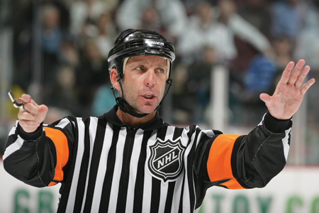

Research Objectives
Fairness – Is the Current Point System Fair?
  Optimization Model to Determine Which Teams Make the Playoffs for Different Point Systems
  Use optimization model to assess potential flaws in the current point system
Entertainment – Does the current point system influence style of play?
  Statistical analysis of gameplay
  Comparison of game statistics in the first 55 minutes and last 5 minutes when it’s a tied game

Slide 5
Assessing Fairness: Point Systems and Optimization Model

Slide 6
Point Systems Assessed
Point System Name: | Current | Win-Loss Record | 3-2-1-0 | 2000-2004 | 1984-1999 | Pre-1983
Situation: | Point Values:
Regular-time Win | 2 | 2 | 3 | 2 | 2 | 2
Regular-time Loss | 0 | 0 | 0 | 0 | 0 | 0
Tie | NA | NA | NA | 1 | 1 | 1
Overtime Win | 2 | 2 | 2 | 2 | 2 | NA
Overtime Loss | 1 | 0 | 1 | 1 | 0 | NA
Points Awarded Change? | Yes | No | No | Yes | No | No
Notes:
Say what “Points Awarded Change?” means

Slide 7
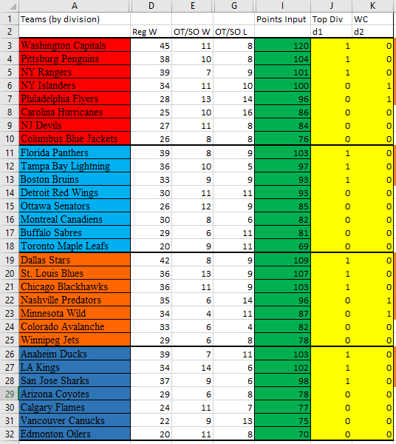
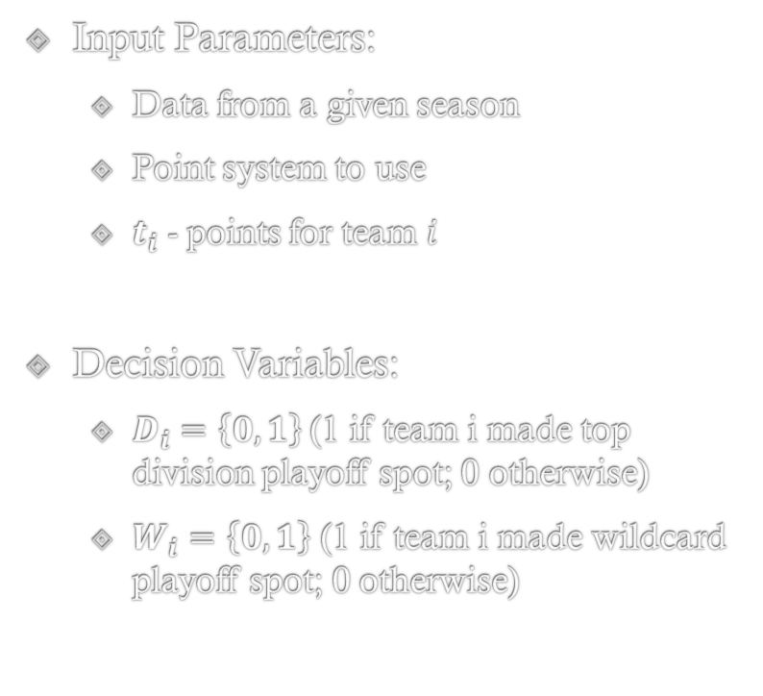
Optimization Model
Input Parameters:
  Data from a given season
  Point system to use
  $t_{i}$ - points for team $i$
Decision Variables:
  $D_{i}=\left\{0,1\right\}$(1 if team i made top division playoff spot; 0 otherwise)
  $W_{i}=\left\{0,1\right\}$ (1 if team i made wildcard playoff spot; 0 otherwise)

Slide 8
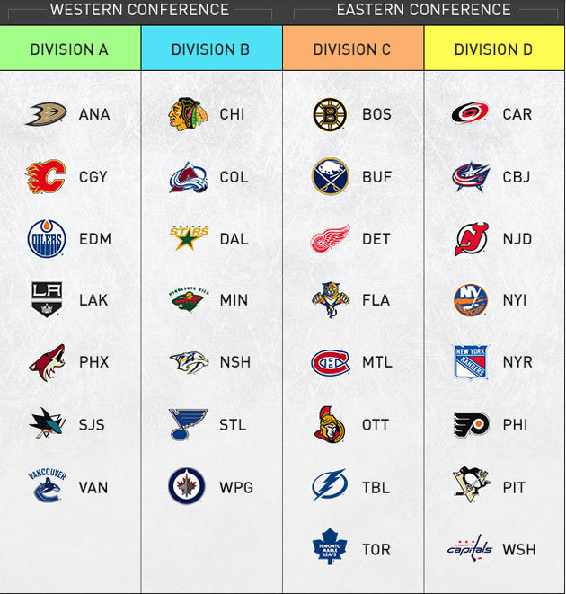

Optimization Model (con’t.)
Objective Function: Maximize Total Points of teams that make the playoff, prioritizing making it top of the division over wildcard.
Constraints: Based on the structure of playoffs and divisions.
Maximize$[2∗\sum_{i=1}^{n}{(D_{i}t_{i}})]+[\sum_{i= 1}^{n}{(W_{i}t_{i}})]$ | (1)
$$\sum_{i=1}^{n}{\left(D_{i}\right)}+\sum_{i=1}^{n}{\left(W_{i}\right)}=16$$ | (2)
$\sum_{i=1}^{n}{\left(c_{i}+p_{i}\right)\left(D_{i}+W_{i}\right)}=8$ ; $\sum_{i=1}^{n}{\left(a_{i}+m_{i}\right)\left(D_{i}+W_{i}\right)}=8$ | (3)
$$D_{i}+W_{i}≤1 ∀i=1, 2, …, n$$ | (4)
$\sum_{i=1}^{n}{\left(p_{i}\right)\left(D_{i}\right)=3}$ ;$\sum_{i=1}^{n}{\left(c_{i}\right)\left(D_{i}\right)=3}$ $\sum_{i=1}^{n}{\left(a_{i}\right)\left(D_{i}\right)=3}$; $\sum_{i=1}^{n}{\left(m_{i}\right)\left(D_{i}\right)=3}$ | (5)
$$D_{i}=\left\{0,1\right\} ∀i=1…n$$ $$W_{i}=\left\{0,1\right\} ∀i=1…n$$ | (6)

Slide 9
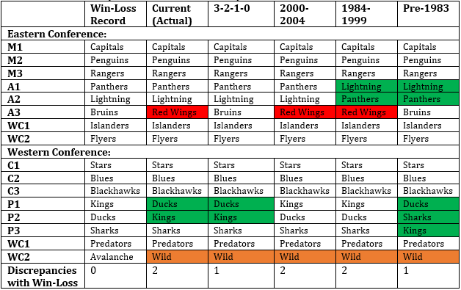
Results of Optimization Model
Notes:
Relate example table to graph
Maybe take out green

Slide 10
Assessing Entertainment:
Does the Current Point System Statistically
Modify Style of Play?

Slide 11
Statistical Analysis
What changes style of play?
Assumptions about statistics and their correlation to passive play:
  Shots – aggressive play
  Faceoffs – passive play – occur due to goals, icing, off-sides, shots (where goalie holds puck) and penalties
  Hits, Blocks, and Penalties – aggressive play
Hypothesis: the point system impacts play of game because if the game is tied and it is close to the end of regulation, teams adopt a new less aggressive strategy to the way they play.

Slide 12
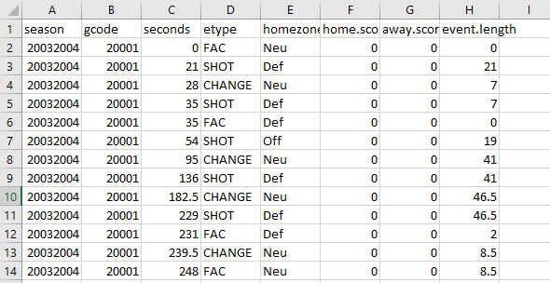
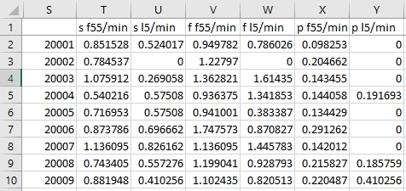
Data Collection
R-package “nhlscrapr” – play by play data from games since 2003-2004 season
Parsed and summarized by game when even play to calculate per minute statistic for:
  First 55 minutes
  Last 5 minutes
Notes:
Spend more time here (walk through what exactly I did)
Only data taken when game was tied
Calculated per minute

Slide 13
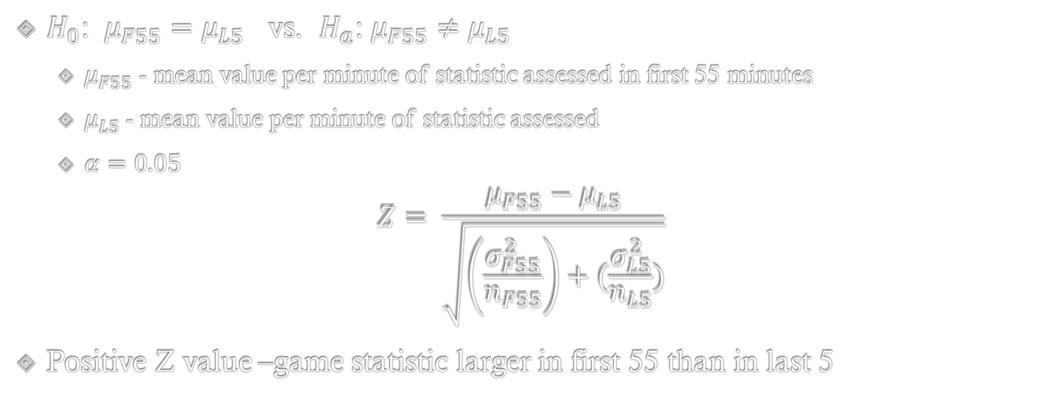
Hypothesis Tests: Paired z-tests
$H_{0}$: ${μ_{F55}=μ}_{L5}$ vs. $H_{a}$: ${μ_{F55}≠μ}_{L5}$
  $μ_{F55}$ - mean value per minute of statistic assessed in first 55 minutes
  $μ_{L5}$- mean value per minute of statistic assessed
  $α=0.05$
$$Z= \frac{μ_{F55}−μ_{L5}}{\sqrt{\left(\frac{σ_{F55}^{2}}{n_{F55}}\right)+(\frac{σ_{L5}^{2}}{n_{L5}})}}$$
Positive Z value –game statistic larger in first 55 than in last 5

Slide 14
Statistical Results
 |  | Shots |  | Face-offs |  | Penalties |  | Hits |  | Blocks
Season | N | Z | p value | Z | p value | Z | p value | Z | p value | Z | p value
2003-2004 | 364 | 1.66 | .049 | -2.53 | .0058 | 6.93 | <.0001 | NA | NA | NA | NA
2005-2006 | 364 | 2.62 | .0043 | -2.54 | .0055 | 5.26 | <.0001 | 4.43 | <.0001 | 2.23 | .013
2014-2015 | 357 | 1.53 | .064 | -2.91 | .0018 | 2.18 | .0148 | 6.34 | <.0001 | 1.19 | .12
2015-2016 | 337 | 1.17 | .121 | -2.89 | .0019 | 5.12 | <.0001 | 4.66 | <.0001 | .809 | .19
Penalties and Hits significantly higher
in First 55 min than in Last 5 min
Face-offs lower in First 55 min than in Last 5 min
(statistically significant in all seasons)
Blocks higher in First 55 min than in last 5 min
(not statistically significant)
Shots Higher in First 55 min than in Last 5 min
(statistically significant in all seasons except 2015-2016)
Notes:
Add animations with words – eg: “more shots in first 55 than in last 5”
More shots in First 55 than last 5 (statistically significant for all except 2015-2016 season)
More face-offs in Last 5 than first 55 (statistically significant for all years)
Many more penalties and hits in first 55

Slide 15
Summary/Suggestions
Current system
  Incorporates fairness of modifying game from regulation to overtime
  Statistically more passive play found in last 5 minutes of regulation when game tied
3-2-1-0 system
  Also incorporates fairness of modifying game from regulation to overtime
  Provides motivation to end in regulation – standard (or more entertaining) style of play in final minutes

Slide 16

Thank you! Questions or Comments

